Slide 1

Copyright
Tutor:
Ruchira de Silva
Team Members:
Bimarsha Basnet (12118883)
Bishal Budhathoki (12116421)
Bishwash Shrestha (12121211)
Prasan Ghimire (12113705)
Assessment-1
Presentation
Term-1: 2020

Slide 2
Purpose:
To make one well known about the use of copyright and plagiarism in their academic and professional institution
To have idea on what kinds of works have copyright
Who will be the owner of copyright?

Slide 3
Copyright
Right given to creator of the creative work so that no one can reproduce their work without their prior consent.
In Australia, copyright law is contained in the Commonwealth Copyright Act 1968 (Copyright Act).

Slide 4
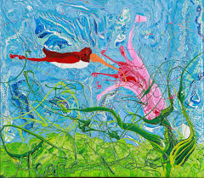
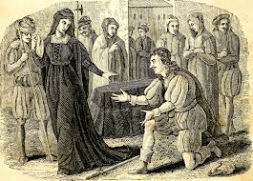

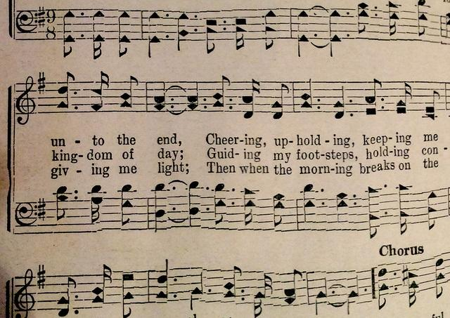
What are protected?
Artistic Works
Dramatic Works
Musical Works
Literary Works
Sound recordings and radio broadcasts
Films and television broadcasts

Slide 5
Who owns Copyright?

Slide 6
WHO OWNS THE COPYRIGHT?
The general rule: “author” first owner of copyright
Registered legal ownership remains for decades
Contributes ideas or information suggestion not an author
work jointly owned more than one author

Slide 7
HOW TO REGISTER COPYRIGHT?
01
ELIGIBILITY
02
REGISTRATION FORM
03
APPLICTION SUBMISSION WITH COPY OF WORK
04
CERTIFICATE OF REGISTRATION
Notes:
© Copyright PresentationGO.com – The free PowerPoint and Google Slides template library

Slide 8
RIGHTS OF COPYRIGHT OWNER
REPRODUCTION
OWNER
DISTRIBUTION
CREATE ADAPTION
PERFORMANCE AND DISPLAY

Slide 9
Should you CARE?
Plagiarism & Copyright

Slide 10
Why we should care?
For plagiarism:
Low grade or even fail if he/she doesn’t give reference or credit to owner.
Can be expelled student if plagiarism occurs many times.
For the copyright:
If one has copied the other work without notifying them then they should fulfill the fine as demanded by owner.
If this doesn’t settle then one can issue case for illegal copyright act and can be behind the bars too.

Slide 11
Copyright occurs when we use others work without permission of rightsholders.
Only holds for the certain time of interval.
Example: from audio library we can add audio in our content without any worrying.
Plagiarism occurs when we deny others work.
Ideas and words should be credit to person who has reviewed and have published his work and holds almost forever.
Example: quotes that are still attributed to Plato.

Slide 12
How to avoid it?
Does the copyright subsist the work of other authors?
Do you have permission from author to reuse, reproduce, perform, communicate and make an adaption of the work?
Do you have the correct information in respect to author reference too?
1
2
3

Slide 13
CQU & Copyright
CQU respects other people’s Intellectual property

Slide 14
CQU with Copyrights
has Part-time Copyright Officer
Educate and consult staff
CQU got copyrighted materials
copyright@cqu.edu.au legaladvice@cqu.edu.au

Slide 15
Uni Teaching & Learning
Students to read online resource
Provided link to resource
Provide access not share
Password protected resource
Teachers should
Not make copies
Distribute and share
Copied/shared for educational purpose
Uni
Buy license and provide
Copy 10% of page/chapter, /student/course
If student needs any, should buy

Slide 16
Conclusion
Own the COPYRIGHT
The shield for the creator
Any creativity can be protected
Plagiarism & Copyright are distinct
Education provider & receiver needs to be alert

Slide 17
References
Australian Copyright Council. n.d. “Copyright and COVID-19”. Retrieved from
https://www.copyright.org.au/ACC_Prod/ACC/COVID-19_info/Copyright_and_COVID-19.aspx
Carla S. Myers (2018) Plagiarism and copyright: Best practices for classroom education, College & Undergraduate Libraries, 25:1, 91-99, DOI: 10.1080/10691316.2017.1391028https://www-tandfonline-com.ezproxy.cqu.edu.au/doi/pdf/10.1080/10691316.2017.1391028?needAccess=true
CQUniversity (2020). Copyright for Student-General Information. Retrieved from https://www.cqu.edu.au/copyright/copyright-@-cquniversity/students

Slide 18
Levalvision. (2018). “How Copyright Protects Writers in Australia”. Retrieved from https://legalvision.com.au/how-copyright-protects-writers/?fbclid=IwAR3anZLKSojBrr3mlqdB5nwOnqSuBvDPa_MPBqgOy-403hs4VDK-1wlVkDw
Li, J. (2017). HOW TO AVOID COPYRIGHT INFRINGEMENT. Training & Development, 44(3), 24-25.https://cqu-primo.hosted.exlibrisgroup.com/primo-explore/fulldisplay?docid=TN_proquest1933842958&context=PC&vid=61CQU&lang=en_US&search_scope=61CQU_Library&adaptor=primo_central_multiple_fe&tab=61cqu_library&query=any,contains,how%20to%20avoid%20copyright,AND&mode=advanced&pfilter=pfilter,exact,articles,AND&pfilter=creationdate,exact,5-YEAR,AND&offset=0

Slide 19
Figures
Adapted from “Work 2013-2014,” by Wiliam Flewellen Heard, n.d, http://williamflewellenheard.com/slide_show5.php.
Adapted from “Transatlantic Accents: Two Stunning Musical Works Converse Across the Pond,” by WOSU public media, 2018, https://radio.wosu.org/post/transatlantic-accents-two-stunning-musical- works-converse-across-pond#stream/0.

Slide 20
Adapted from “The dramatic works of William Shakespeare - accurately printed from the text of the corrected copy left by the late George Steevens,” by Internet Archieve Book Images, 2015, https://commons.wikimedia.org/wiki/File:The_dramatic_works_of_Willia m_Shakespeare_- _accurately_printed_from_the_text_of_the_corrected_copy_left_by_the _late_George_Steevens,_Esq._- _with_a_glossary,_and_notes,_and_a_sketch_of_the_life_of_(1478007 2744).jpg
Adapted from “ Literacy Work Translation,” by Lingotrans Services Pte Ltd, 2020, https://www.streetdirectory.com/businessfinder/page/132528/22166/6018/

Slide 21
Thanks!
Any questions?

